Slide 1
Amazon Products Sales Analysis
Year-to-Date Performance Insights
Created in Power BI

Slide 2
Objective
• Analyze Amazon product sales performance over time
• Identify top-performing product categories and items
• Discover seasonal sales patterns and customer review trends

Slide 3
Key Metrics
YTD Sales: $2.18M
QTD Sales: $811.09K
YTD Products Sold: 27.75K
YTD Reviews: 19.42M

Slide 4
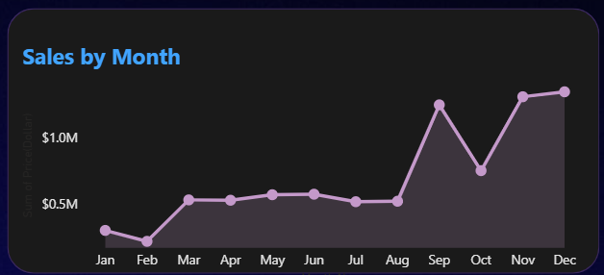
Sales Trends
• Monthly sales show peaks in September and November
• Weekly sales reveal consistent growth with seasonal spikes

Slide 5
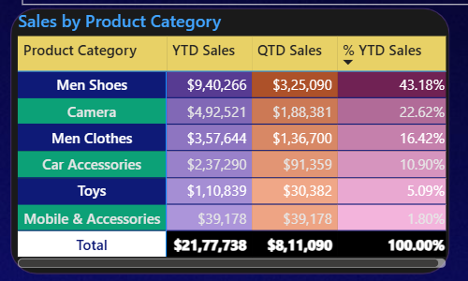
Category Performance
• Men’s Shoes → 43.18% of YTD Sales ($940K)
• Cameras → 22.62% ($492K)
• Mobile Accessories → Lowest share (1.8%)

Slide 6
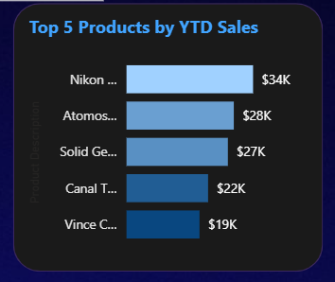
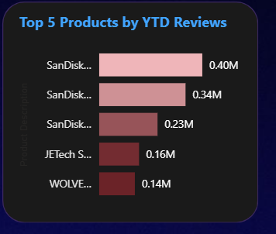
Top Products
• Top Sales: Nikon ($34K), Atomos ($28K), Solid Gear ($27K)
• Top Reviews: SanDisk (0.40M, 0.34M, 0.23M), JETech (0.16M)

Slide 7
Recommendations
• Increase stock/promotions for Men’s Shoes & Cameras
• Boost marketing during peak months (Aug–Nov)
• Enhance visibility for low-performing categories

Slide 8
Tools Used
• Power BI – Data visualization & dashboard creation
• Excel/CSV – Data cleaning & preparation
• Amazon Sales Dataset – Source data

